Slide 1
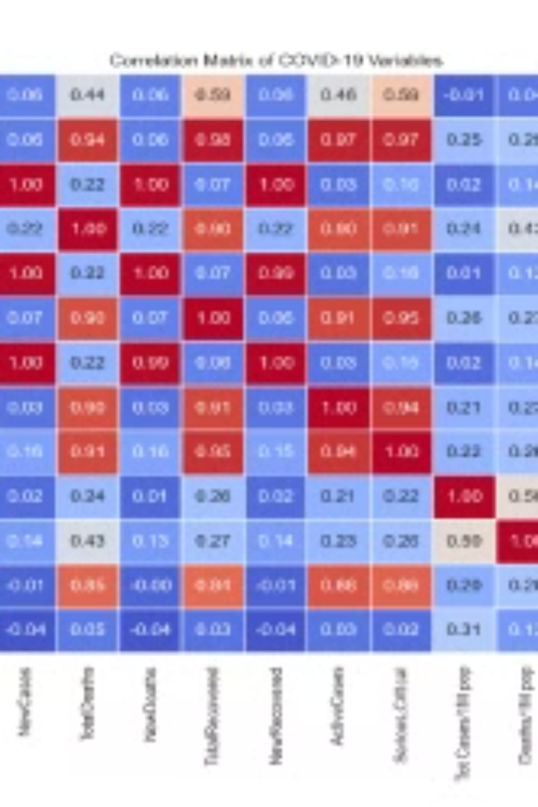

Technical Report: Data Science Analysis Of Covid-19 Case Scenario
This report presents a comprehensive analysis of a COVID-19 dataset, utilizing data science techniques to uncover insights, develop predictive models, and provide recommendations for public health interventions. The analysis encompasses data cleaning, exploratory data analysis (EDA), predictive modeling, and evaluation of the results.
by Deborah Omeje

Slide 2

Introduction
This report details the analysis of a COVID-19 dataset to derive insights, create predictive models, and offer recommendations for public health interventions. The analysis includes data cleaning, exploratory data analysis (EDA), predictive modelling, and evaluation of results.

Slide 3

1. Data Preparation
Handling Missing Values
Outliers
Imputation techniques were employed to replace missing numerical features with their respective medians and categorical features with their modes.
Outliers were detected and addressed through interquartile range (IQR) and domain knowledge validation.
Feature Engineering
Scaling and Transformation
New attributes were derived to capture important trends or improve predictive power, such as case growth rates.
Features were normalized/scaled to enhance predictive capabilities and to improve model performance.

Slide 4
2. Exploratory Data Analysis (EDA) And Visualization
1
Descriptive Statistics
2
Correlation Heatmap
Summarized central tendencies and distributions for numeric variables.
Showed relationships between features to identify multicollinearity.
3
Case Trends Over Time
4
Age and Severity Correlation
Confirmed cases exhibited exponential growth during the initial stages, followed by periods of stabilization and decline.
Higher severity and mortality rates were associated with older age groups.

Slide 5
3. Model Development
Algorithms Used
Hyperparameter Tuning
Cross-Validation
Logistic Regression
Applied grid search/random search for optimization.
Ensured robustness of results.
Random Forest
Gradient Boosting (XGBoost)

Slide 6
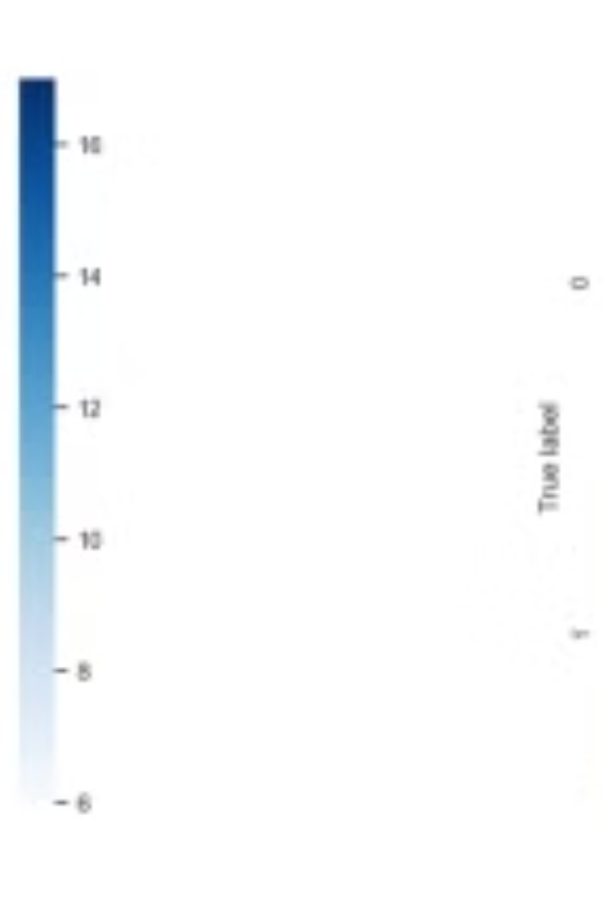
4. Model Evaluation
Tuned Accuracy
0.5952
Tuned Precision
0.5556
Tuned Recall
0.5263
Tuned F1-Score
0.5405
RMSE
370149.9380

Slide 7




5. Insights And Recommendations
Targeted Interventions
Allocate healthcare resources preferentially to regions with high population densities and older demographics.
Surveillance and Early Detection
Emphasize testing and monitoring in hotspots with rising case trends.
Community Outreach
Promote public health awareness campaigns and encourage adherence to preventive measures.

Slide 8
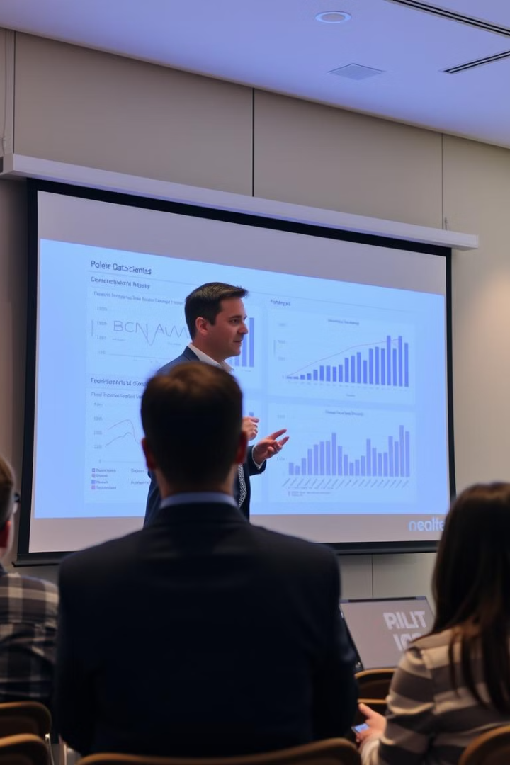
6. Conclusion
The analysis provides actionable insights into COVID-19 spread and outcomes. The predictive models can support policymakers in resource allocation and crisis response planning. Further research with updated datasets is recommended to refine these findings and adapt to evolving conditions.

